Slide 1
Creative Engineering Design
Bail Robert
Class number & Time slot
412990-7 / Thu1,2,3,4
Student ID
32170578
Name
San Kim

Slide 2
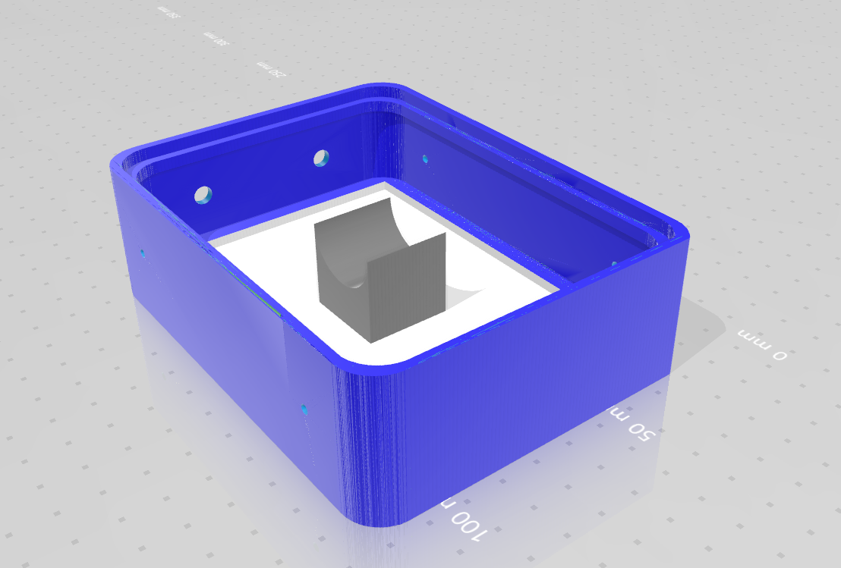
Base Panel
IMAGE

Slide 3
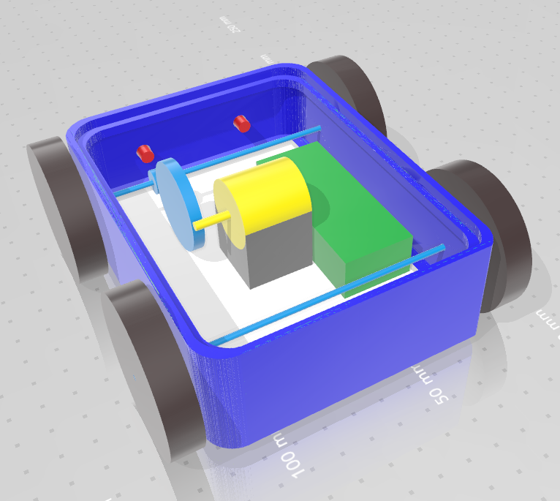
Base Panel with Components
IMAGE

Slide 4

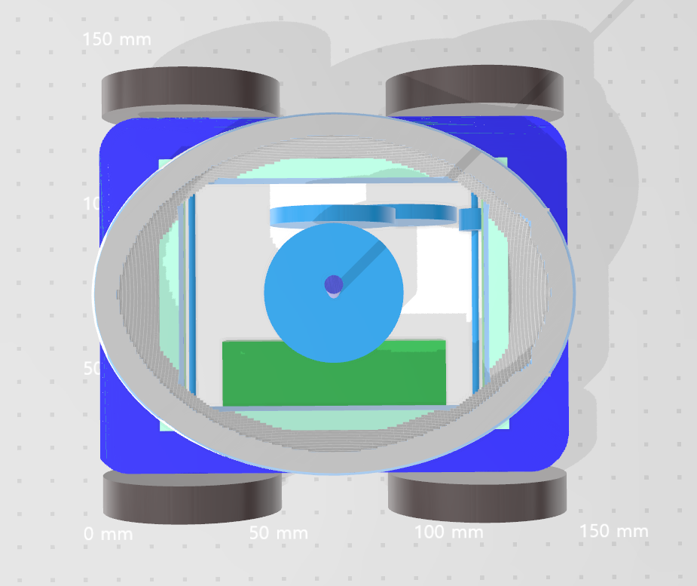
Cover Module
Outside View
Inside View

Slide 5
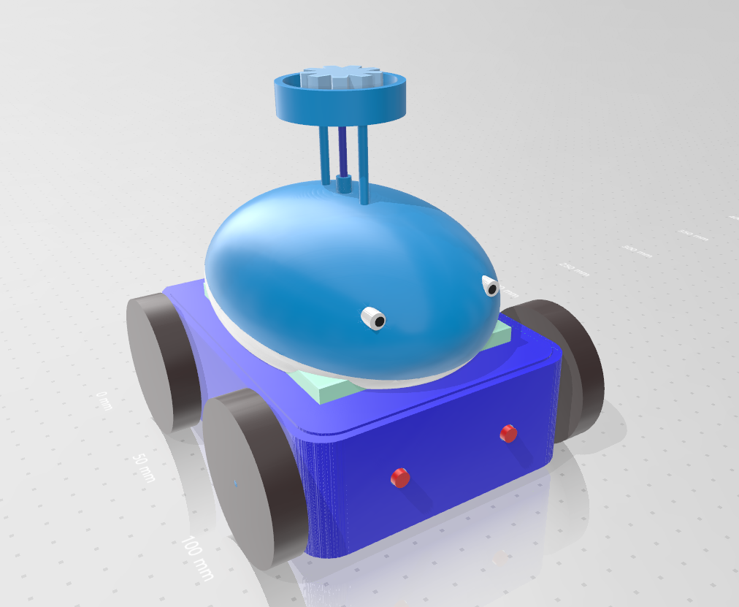
Entire Robot
IMAGE

Slide 6
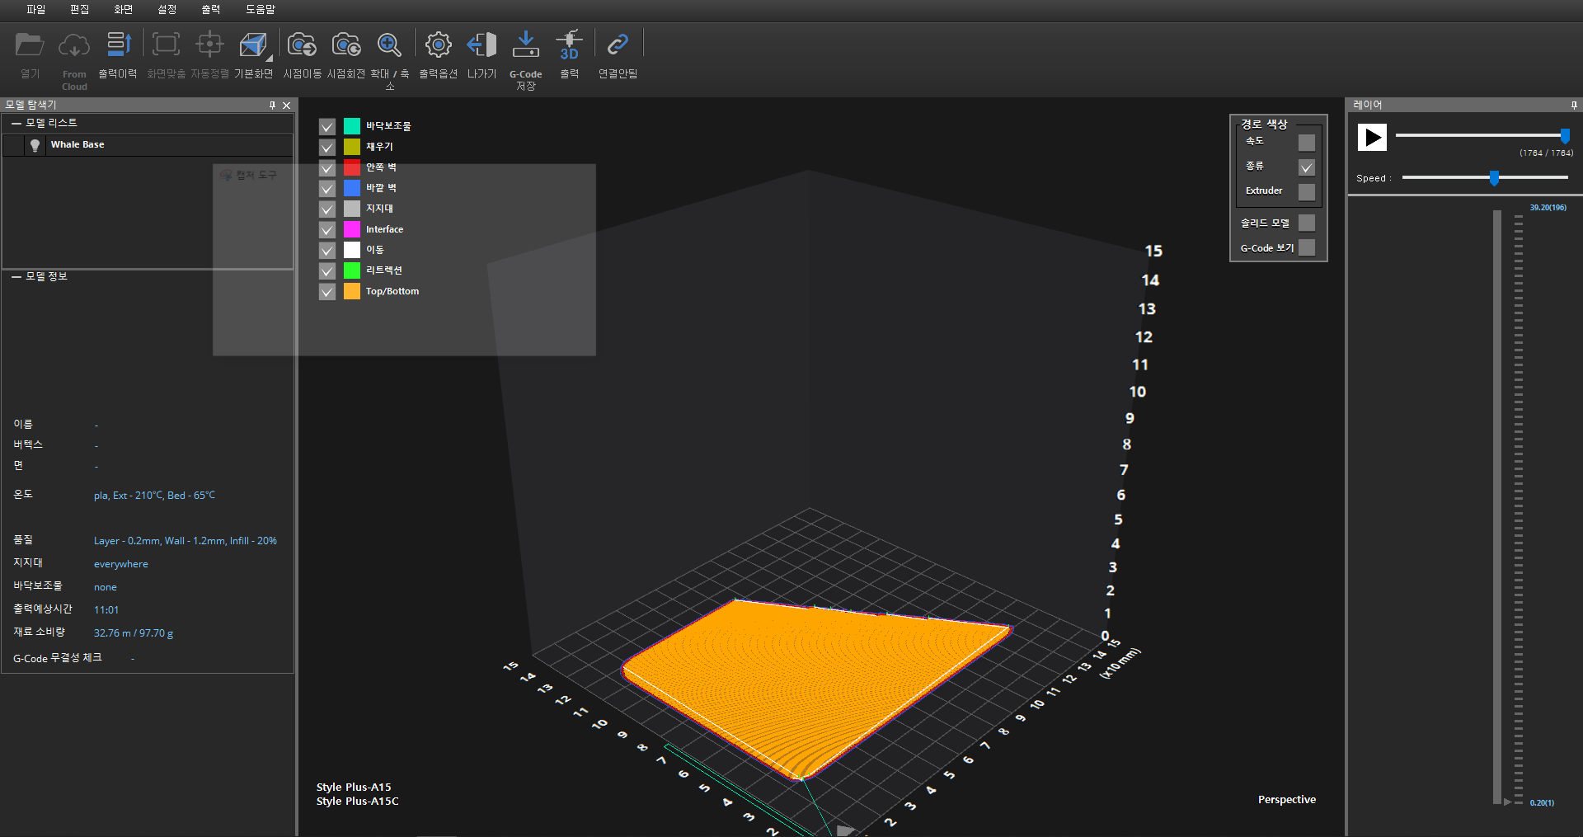
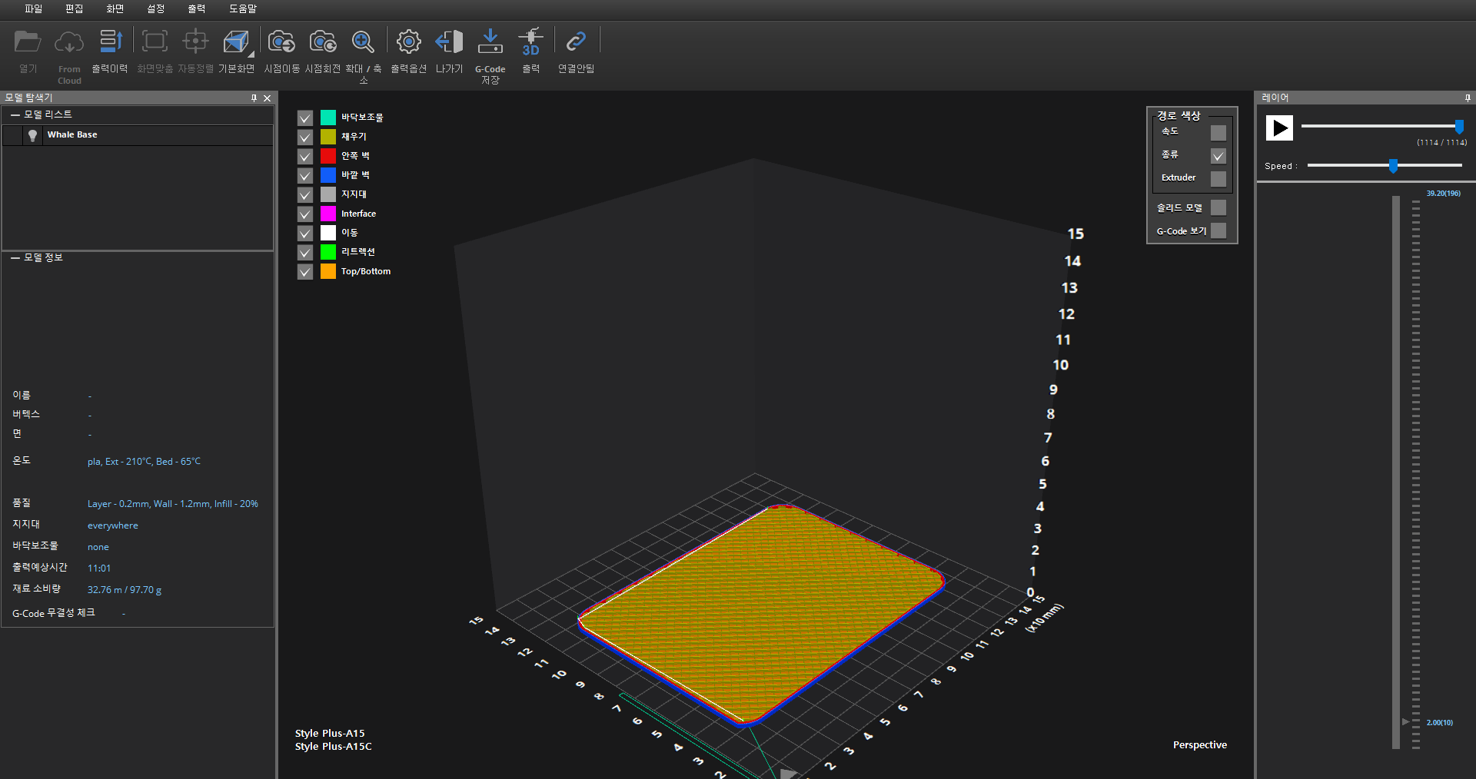
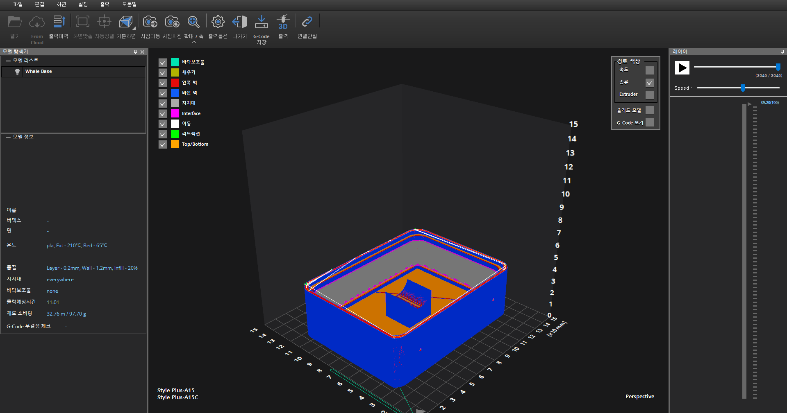
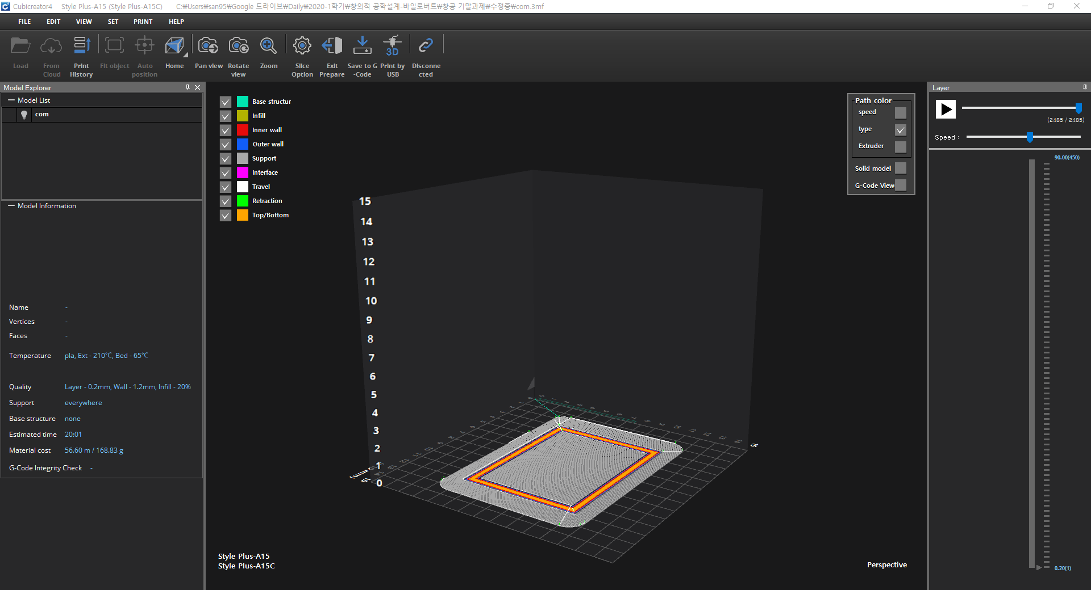
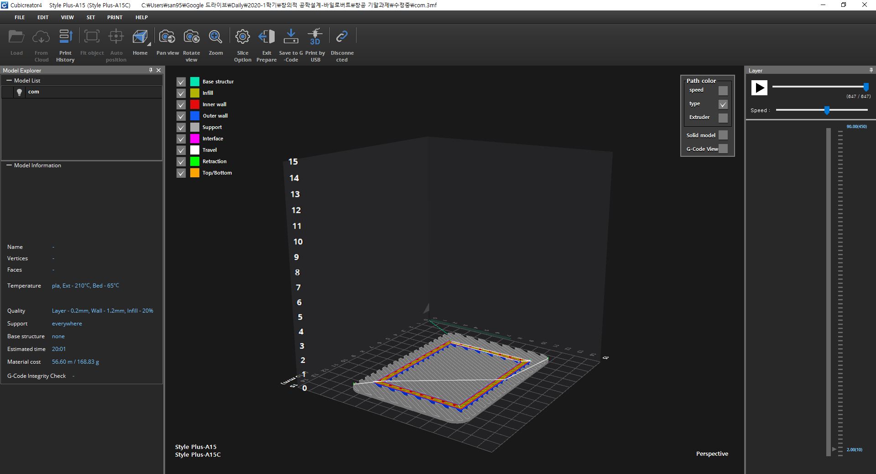
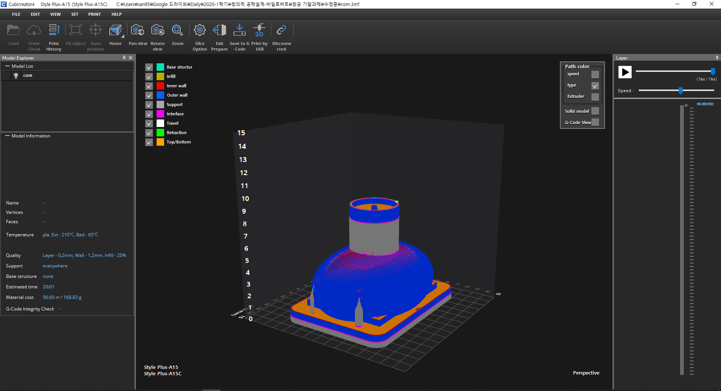
Simulation
Base Module
IMAGE
IMAGE
Cover Module

